Slide 1
Topic 2.
GIS Resources and Projects in DILA

Slide 2
Outline
Project1: Visualizing and Querying Chinese Buddhist Biographies
(佛教傳記文學的視覺化與搜尋)
Project2: Buddhist Temples in Taiwan
(台灣佛寺時空平台)
Project3: Buddhist Studies Authority Database
(佛學規範資料庫)

Slide 3
Visualizing and Querying Chinese Buddhist Biographies
(佛教傳記文學的視覺化與搜尋)
http://buddhistinformatics.dila.edu.tw/biographies/gis/
Search
高僧傳 GIS

Slide 4
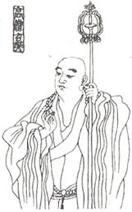
Visualizing and Querying Chinese Buddhist Biographies
The collections of hagio-bio-graphies of eminent Buddhist monks and nuns in China between c. 200 and 1700 CE.
Chu sanzang jiji (Part 5: Biographies) 出三藏記集 (列傳部) by Sengyou 僧祐, completed 510-518
Biqiuni zhuan 比丘尼傳 by Baochang 寶唱, dated 516
Liang gaoseng zhuan 梁高僧傳 by Huijiao 慧皎, dated 519
Tang gaoseng zhuan 唐高僧傳 by Daoxuan 道宣, dated 665
Song gaoseng zhuan 宋高僧傳 by Zanning 贊寧, dated 988
Ming seng zhuan chao 名僧傳抄 , by Sōshō 宗性, 13th cent.
Ming gaoseng zhuan 明高僧傳 by Ruxing 如惺, dated 1600
Buxu Gaoseng Zhuan 補續高僧傳 by Minghe 明河, dated 1647
Total About 2900 biographies.

Slide 5
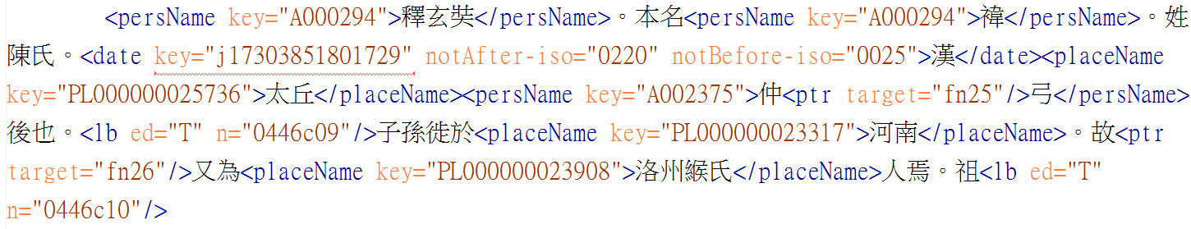
Markup Text with TEI
釋玄奘 。本名褘。姓陳氏。漢 太丘 仲弓後也。子孫徙於河南。故又為洛州緱氏人焉。祖康北齊國子博士。父慧早通經術。長八尺明眉目。拜江陵令。解纓而返。即大業末年。識者以為剋終。隱淪之候故也。兄素出家。即長捷法師也。容貌堂堂儀局瓌秀。講釋經義聯班群伍。住東都淨土寺。以奘少罹窮酷。携以將之。日授精理。

Slide 6
Indentify person/place/time/event in the text
釋玄奘 。本名褘。姓陳氏。漢 太丘 仲弓後也。子孫徙於河南。故又為洛州緱氏人焉。祖康北齊國子博士。父慧早通經術。長八尺明眉目。拜江陵令。解纓而返。即大業末年。識者以為剋終。隱淪之候故也。兄素出家。即長捷法師也。容貌堂堂儀局瓌秀。講釋經義聯班群伍。住東都淨土寺。以奘少罹窮酷。携以將之。日授精理。
Person 1: Xuan Zhang
Person 2: Xuan Zhang’s father
Place: 河南
(Longitude, latitude)
Time: 大業末年
A Basic Event

Slide 7
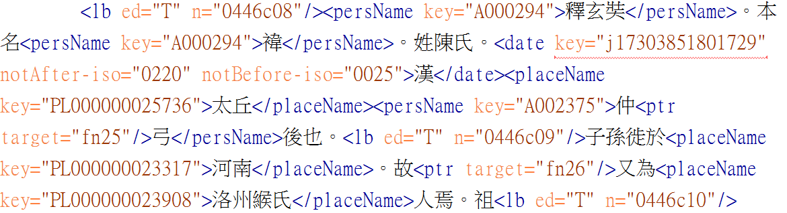
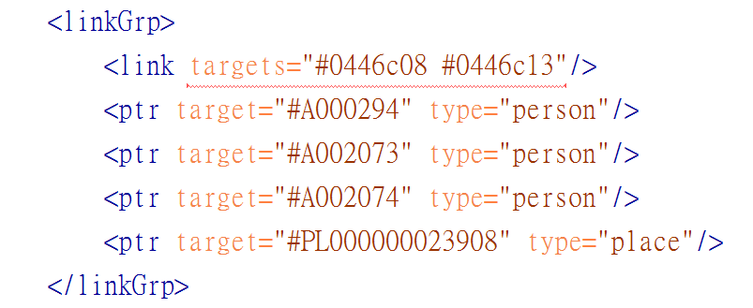
Markup of nexus points
A Nexus Point
Person(s) x was/were at a certain place p at a certain time or period t.
Person 1: Xuan Zhang

Slide 8
DILA Authority Database
Detailed information of persons, places, dates are store in DILA Authority Database.
(http://authority.dila.edu.tw)
Most important: DILA Authority Database provides geographical coordinates of historical places mentioned in 高僧傳 corpus.

Slide 9
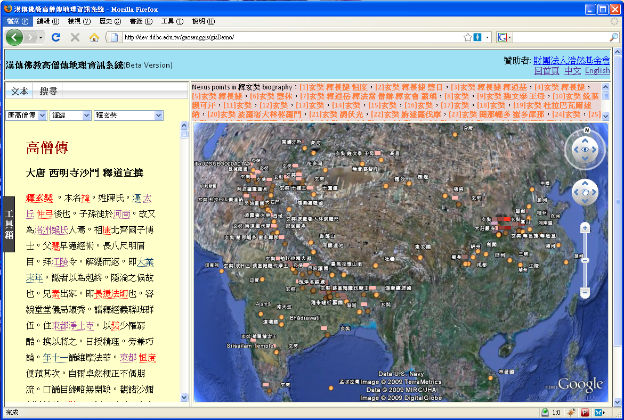

Geographic visualization of Buddhist Biographies
釋玄奘 。本名褘。姓陳氏。漢 太丘 仲弓後也。子孫徙於河南。故又為洛州緱氏人焉。祖康北齊國子博士。父慧早通經術。長八尺明眉目。拜江陵令。解纓而返。即大業末年。識者以為剋終。隱淪之候故也。兄素出家。即長捷法師也。容貌堂堂儀局瓌秀。講釋經義聯班群伍。住東都淨土寺。以奘少罹窮酷。携以將之。日授精理。
URL: http://buddhistinformatics.ddbc.edu.tw/biographies/gis/interface/

Slide 10
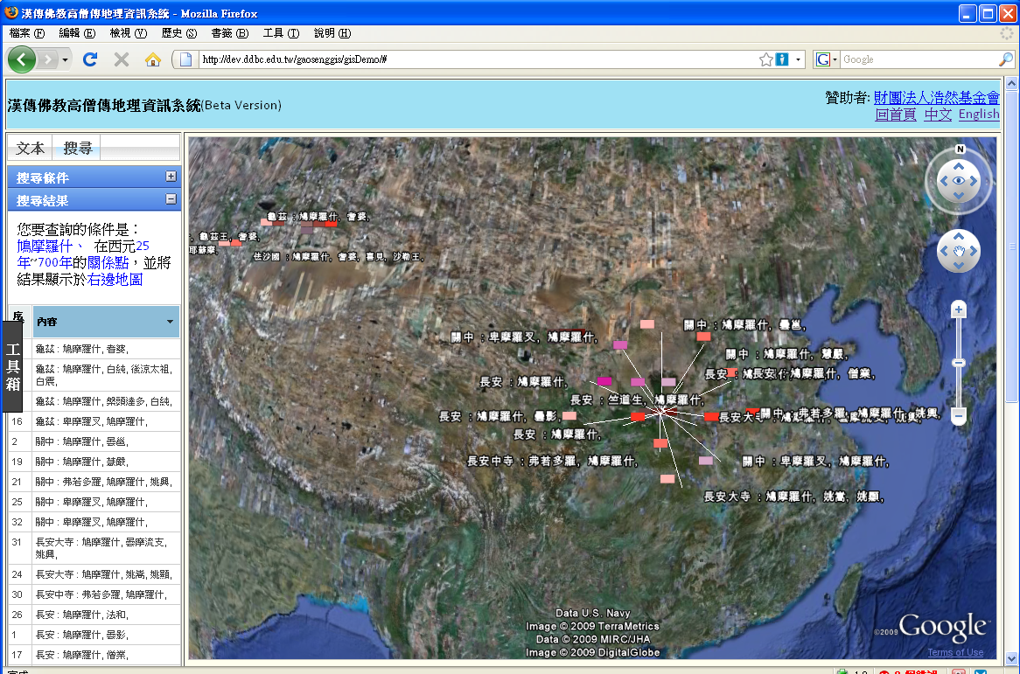
Search using time/person/place condition

Slide 11
Unfortunately, Due to the "Google Earth Browser Plugin", the main technique for visualizing Geometric information, has been deprecated from this March.
We can not directly see map visualizations on 高僧傳's website.
We plan to fix it in summer.

Slide 12
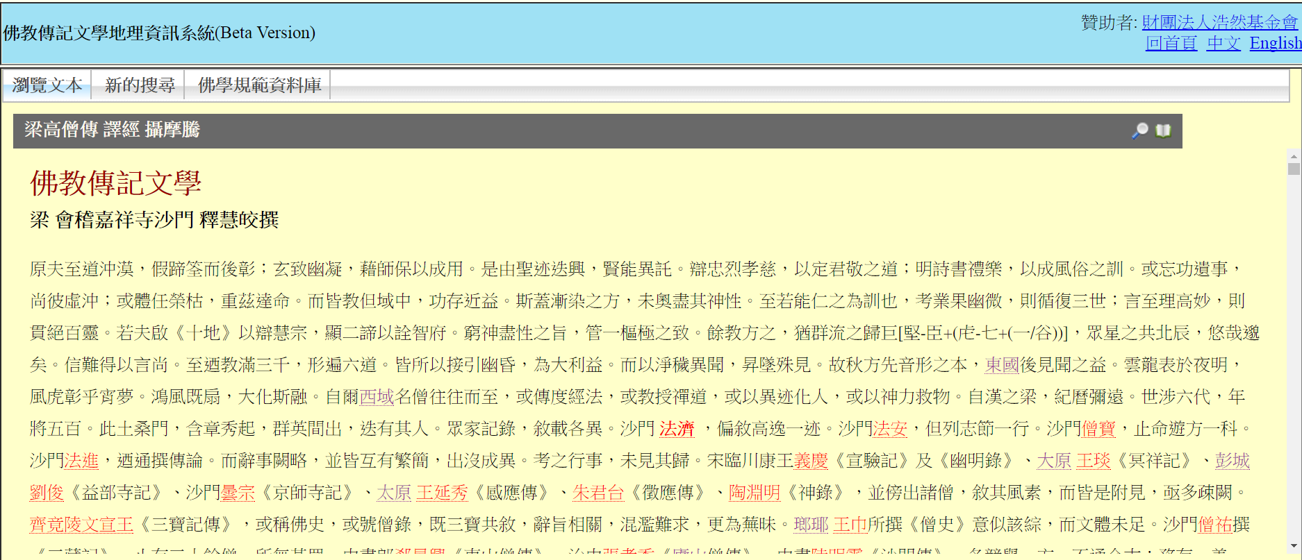
So, now we only have a site of 高僧傳 corpus without GIS.
The interface besides displays the content of 高僧傳 text with all date ,person , place entities annotated, it also provides links for downloading KML containing geometric points mentioned in the text.

Slide 13
Practices with 高僧傳 GIS
Try to download KML from following biographies:
  梁高僧傳 > 譯經 > 釋法顯
  梁高僧傳 > 譯經 > 鳩摩羅什
  唐高僧傳 > 譯經 > 釋玄奘
Try to perform following search:
  Search for all points in 梁高僧傳
  Search for all points related to 唐 dynasty
  Search for all points related to 菩提達摩

Slide 14
Transform KML to PostGis
The best way for us to transform KML to PostGIS Table is through "QGIS" software.
The whole procedure:
  Load KML file as Vector Layer in QGIS
  Save the new Layer as shape file
  Import shape file to PostGIS

Slide 15
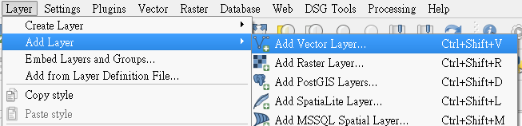
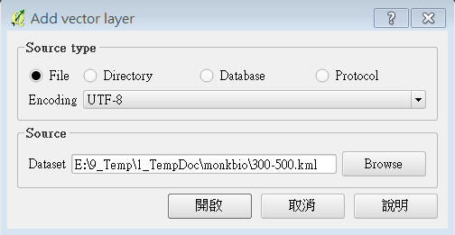
Load KML data into QGIS
Simply use "ADD Vector Layer" and point to the KML file.
Add Layer
Add Vector Layer
Location of KML file
Open

Slide 16
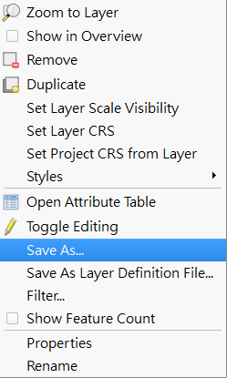
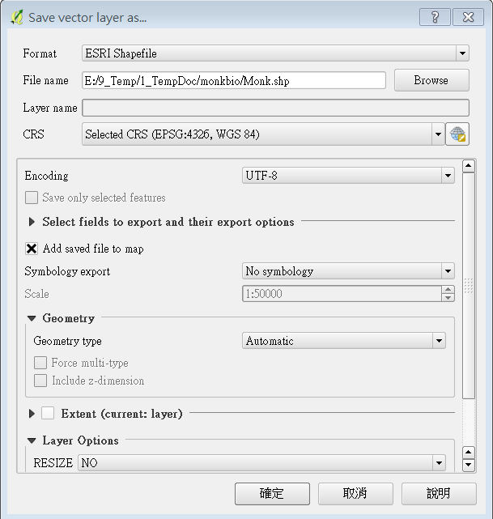
Save Layer to Shape file
Right Click a layer in the layer panel
Format : ESRI Shape File
Filename: for Saving Shape file
CRS: ESPG:4326 WGS 84
Encoding: UTF-8
Save As

Slide 17
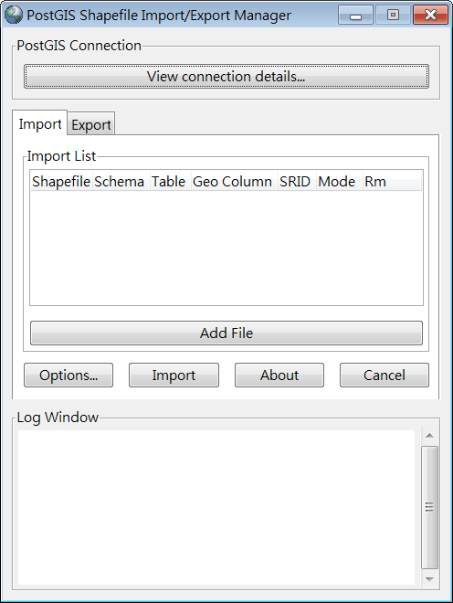
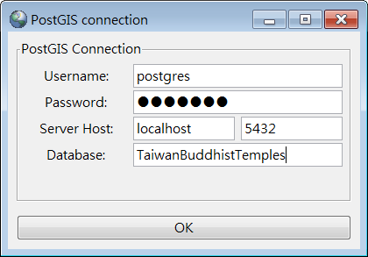
pgShapeLoader Applicaion
User Name:
postgres
Password:
Password of postgres
Connecting: host=localhost port=5432 user=postgres password='*******' dbname=TaiwanBuddhistTemples
Connection succeeded.
Database:
TaiwanBuddhistTemples

Slide 18


> shp2pgsql -s 4326 -g geom -W "UTF-8" -c {path_to_.dbf_file} public.Town | pbcopy
-s: specify SRID of shape file.
-g: specify the name of the field for storing geometric object
-W: text encoding of shape file
-c : for creating Table
{path_to_.dbf_file} : specify the path to the .dbf file
public.Town: the name of the table for storing the data of shape file
> shp2pgsql -s 4326 -g geom -W "UTF-8" -c {path_to_.dbf_file} public.Town | xclip -sel clip
In ubuntu, you have to install xclip first.

Slide 19
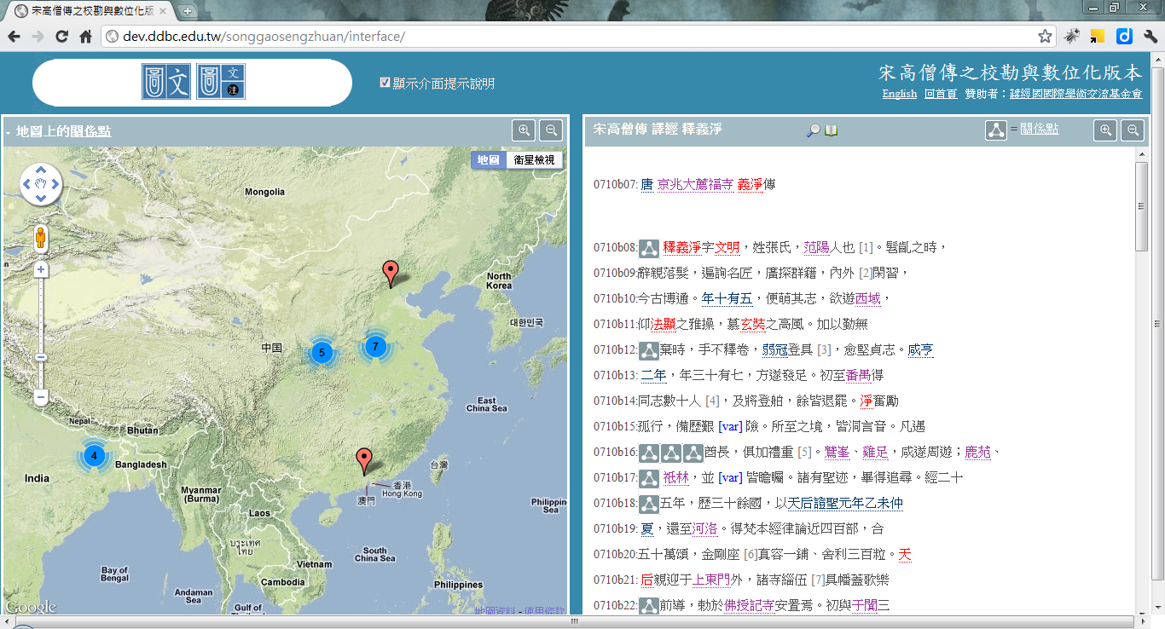
The Song-Dynasty Collection of Biographies of Eminent Monks http://dev.dila.edu.tw/songgaosengzhuan/interface/

Slide 20
Buddhist Temples in Taiwan
(台灣佛寺時空平台)
http://buddhistinformatics.dila.edu.tw/taiwanbudgis/

Slide 21
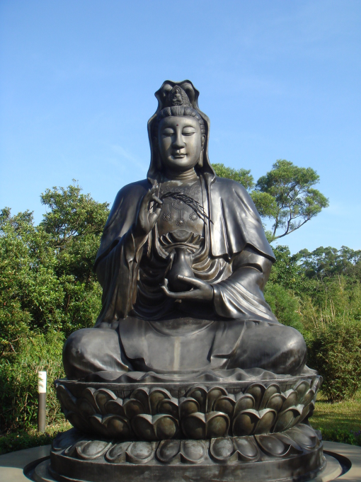
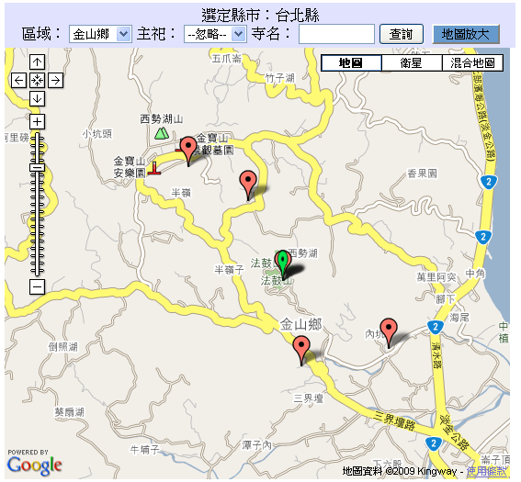
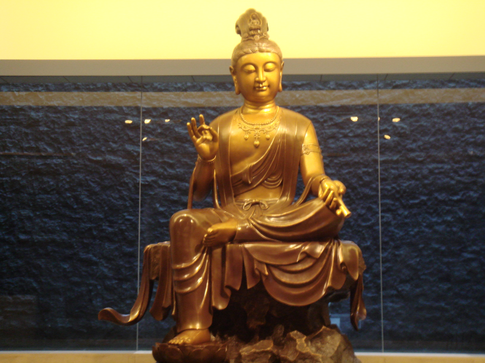
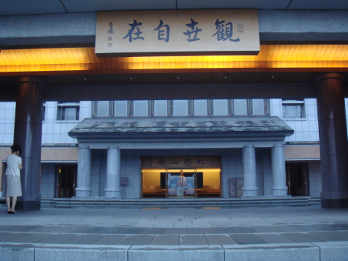
Buddhist Temples in Taiwan
  This project uses geographic information system (GIS) technology to integrate temporal and spatial information about Taiwanese Buddhism, especially the spread and distribution of Buddhist temples and centers of worship.

Slide 22
About The Dataset
As data sources we use previous research done by scholars of Taiwanese Buddhist history. In particular we include the work of Prof. Kan Zhengzong 闞正宗 , who has kindly agreed to serve as advisor for this project.
Data Source: | 資料年代
「 內政部民政司/下載專區/寺廟一覽表 」 Dept. of Civil Affair/Ministry of Interior | 更新至 2010 年版
「水月閣/世界佛教通訊」 | 約 1995 年前後
各寺院專屬網站 | 2007~2010 年
《重修苗栗縣志：宗教志卷八》 | 2007年4月

Slide 23
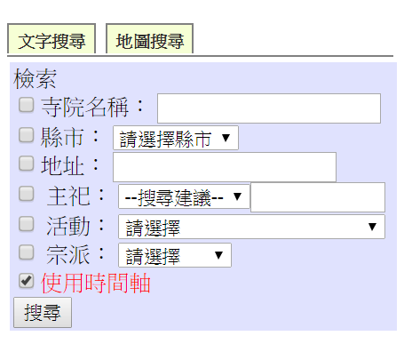
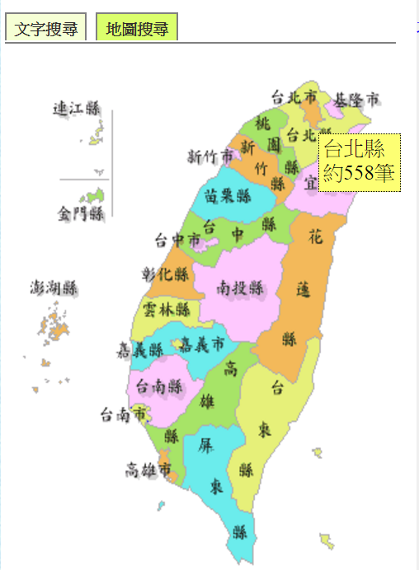
Browse Data of Taiwanese Temples
Search with Metadata
Browse Temples Data by Map

Slide 24
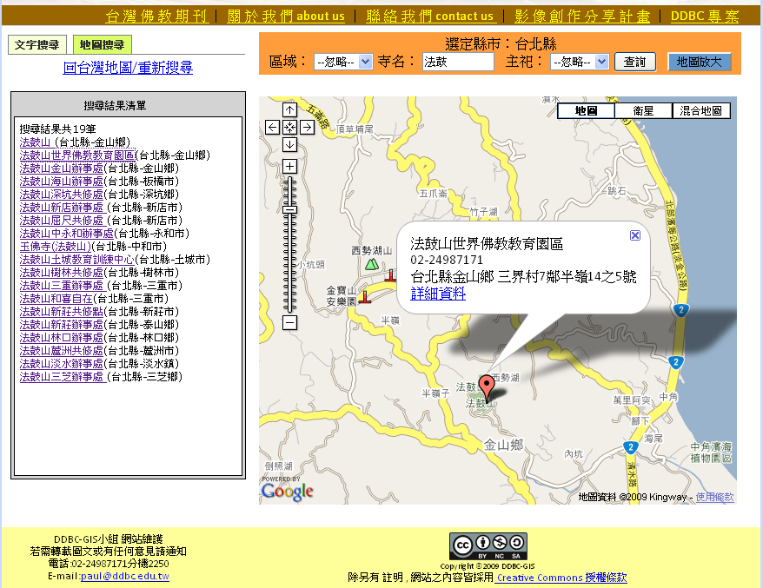
Buddhist Temple in Taiwan - GIS
Collecting temporal and spatial information about Taiwanese Buddhist Temple
Using GIS and Timeline for visualizing data

Slide 25
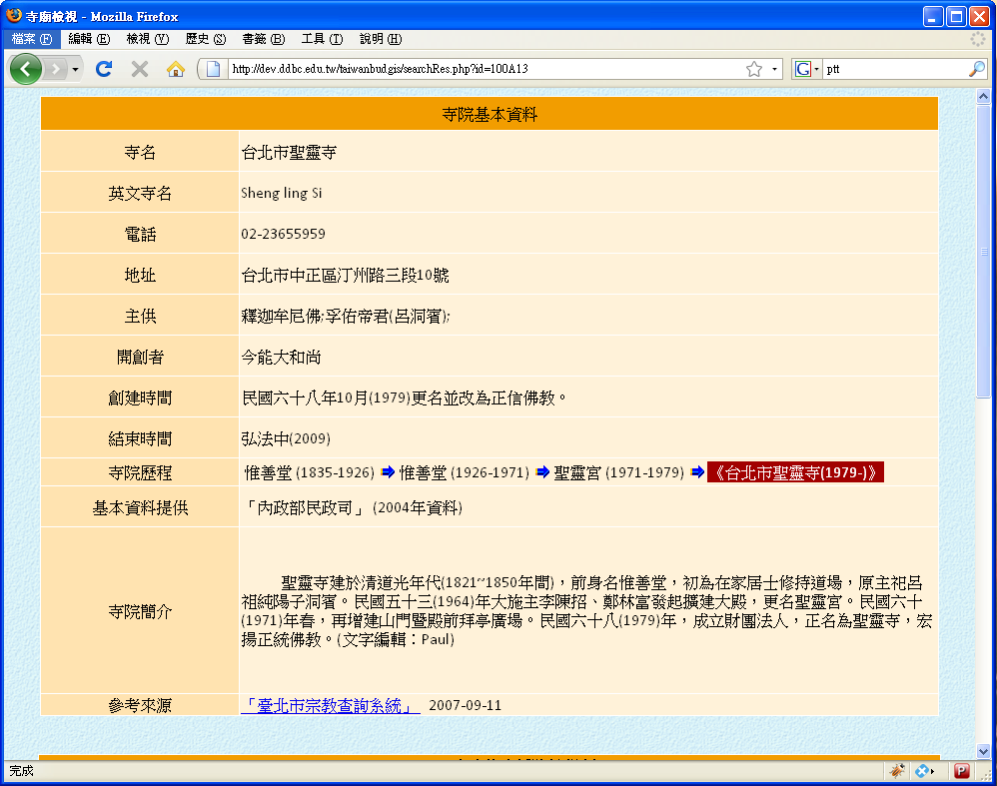
臺灣佛寺資料基本資料
  Basic information of Temples
    Address, Telphone,
    流派(sect?),
    Date of Creation and termination
    Brief Description.
  GIS Applications
    Show location with Google-map
    route navigation

Slide 26
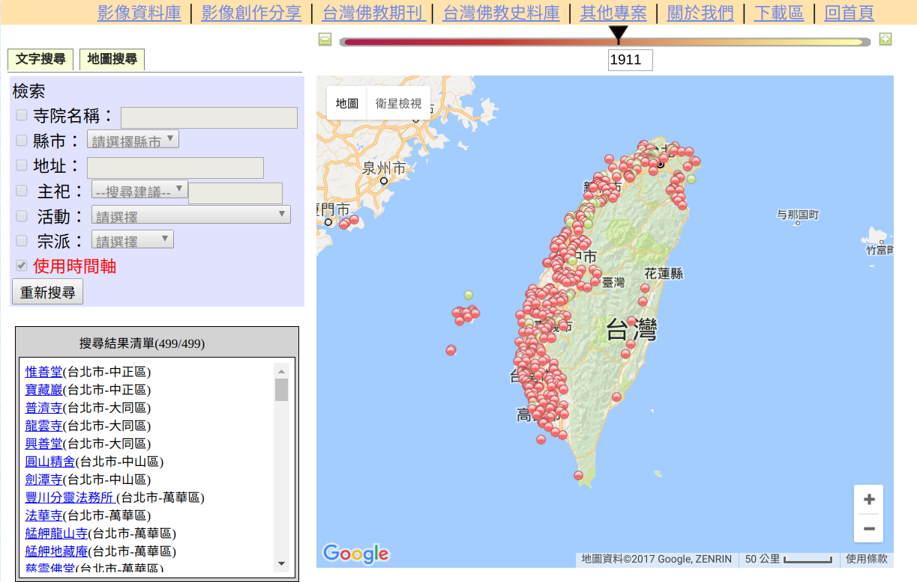
Using Time Bar to Get the Brief Distribution of Taiwanese Temples in Different Era
Taiwanese Buddhist Temples in year 1911
499 Temples

Slide 27
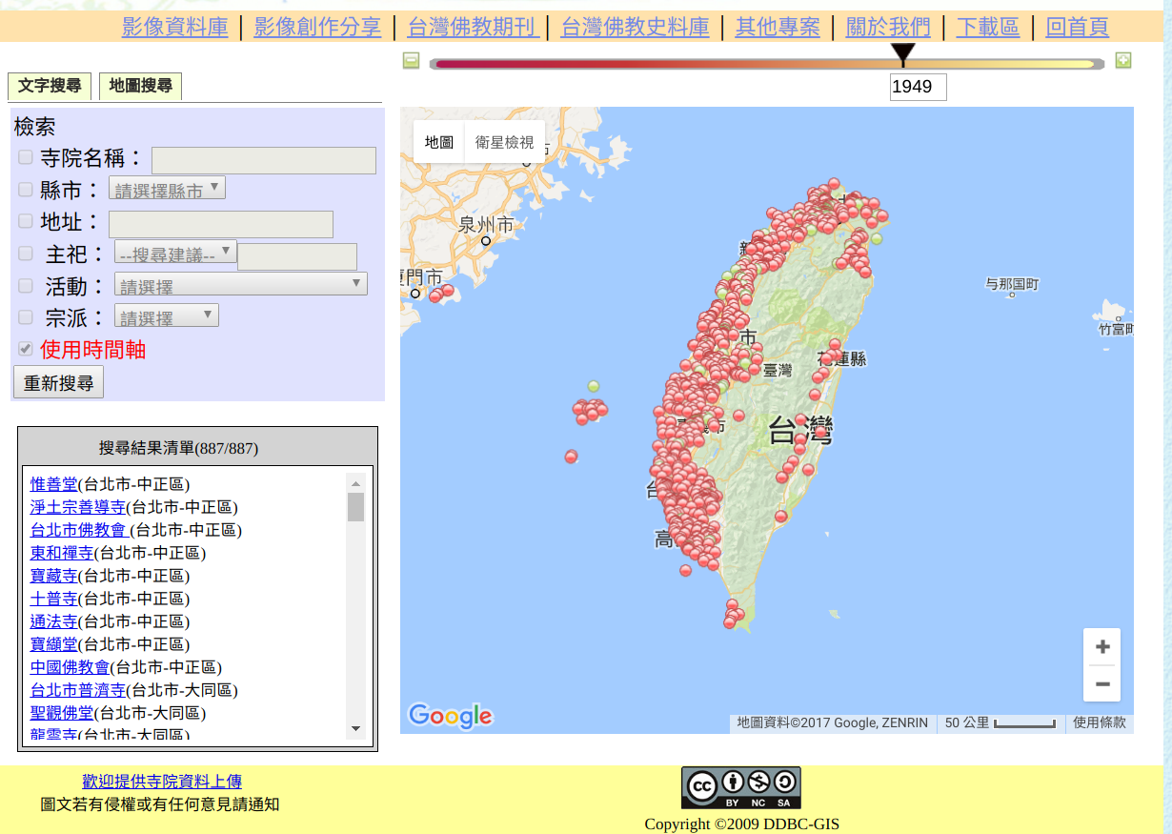
Using Time Bar to Get the Brief Distribution of Taiwanese Temples in Different Era
Taiwanese Buddhist Temples in year 1949
887 Temples

Slide 28
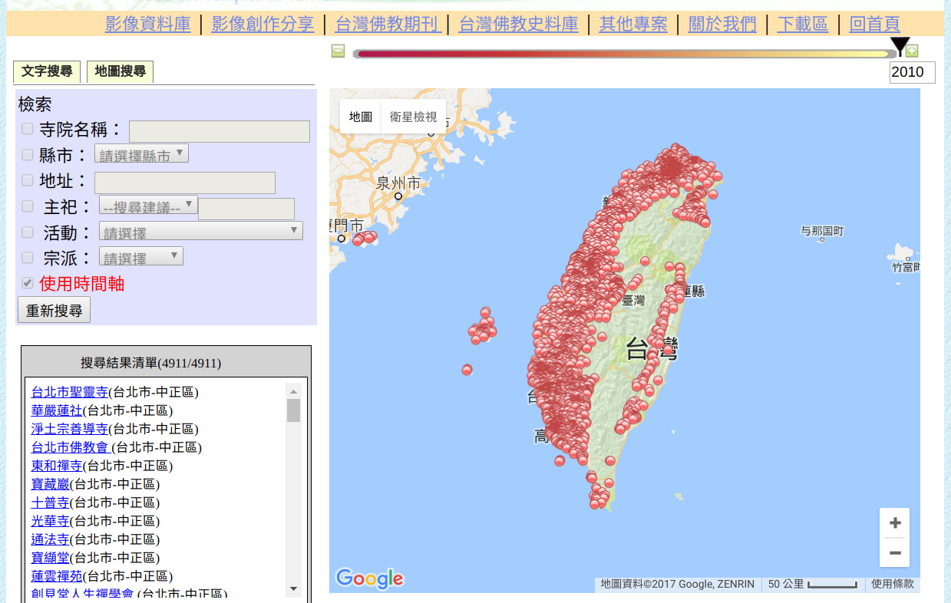
Using Time Bar to Get the Brief Distribution of Taiwanese Temples in Different Era
Taiwanese Buddhist Temples in year 2010
4997 Temples

Slide 29
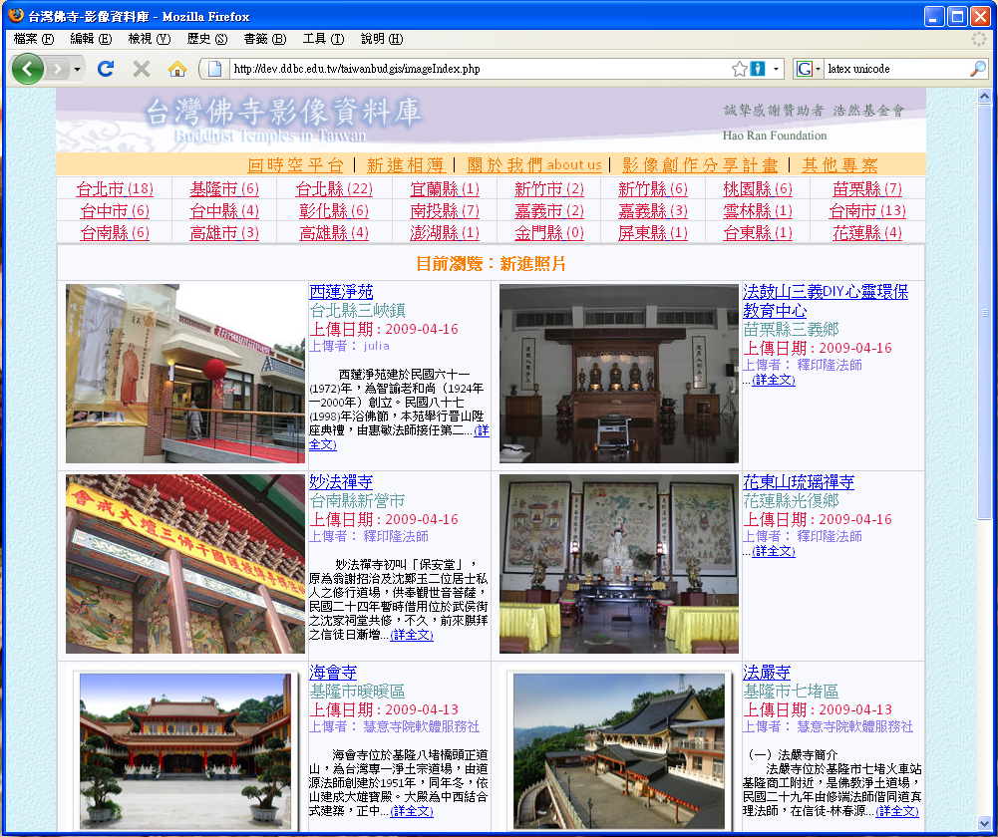
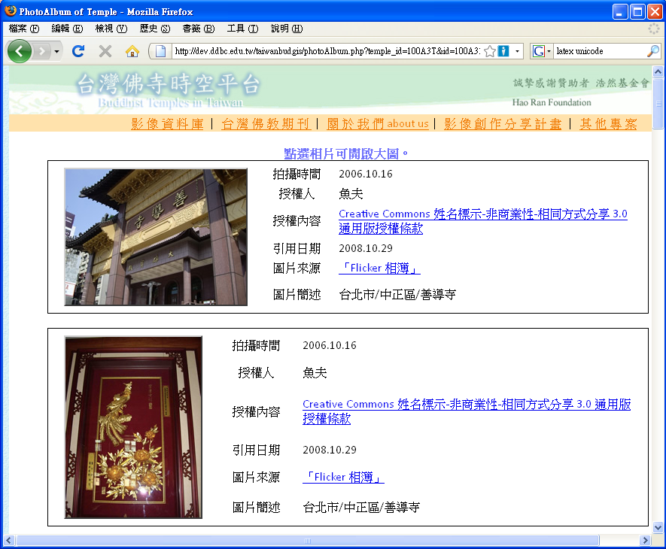
  Buddhist Temple in Taiwan – Image Database
Collect images of Buddhist Temples in Taiwan
Another crowdsourcing example

Slide 30
Download Source Data
You can down the source data in download page.
The zip-archive provided here includes the data of the Buddhist Temples in Taiwan database in XML/TEI (P5). It is distributed under a CC (Attribute - Share Alike) Ver.3 license.
taiwanese_buddhist_temples.zip
[1.28mb, 2010-10-26 09:16]
The Temples.csv, we used for our last lecture, is generated from this XML file.

Slide 31
XQuery Scripts for transforming TEI/XML file of Buddhist Temples in Taiwan to CSV
xquery version "1.0";
declare namespace tei="http://www.tei-c.org/ns/1.0";
declare option output:method "csv";
declare option output:csv "header=yes, separator=comma";
<CSV>
{
for $x in doc("taiwanese_buddhist_temples.xml")//tei:place[not(@next)] return
<record>
<id>{data($x/@xml:id)}</id>
<name>{data($x/tei:placeName[@xml:lang="zh-TW"])}</name>
<trait>{data($x/tei:trait/tei:p)}</trait>
<postCode>{data($x/tei:location/tei:address/tei:postCode)}</postCode>
<longitude>{substring-after(data($x/tei:location/tei:geo),",")}</longitude>
<latitude>{substring-before(data($x/tei:location/tei:geo),",")}</latitude>
<address>{data($x/tei:location/tei:address/tei:addrLine[1])}</address>
</record>
}
</CSV>
BASEX

Slide 32
Buddhist Studies Authority Database
(佛學規範資料庫)
http://authority.dila.edu.tw/

Slide 33
佛學規範資料庫
Buddhist Studies Authority Databases
Our authority database wants to collect all authority entities, including persons, places, time and books related to Chinese Buddhism.
Give each entity a unique authority id.
  東漢 明帝 永平 元年 正月一日(0058-02-01)(1742286)
  鳩摩羅什(Kumārajīva)(A001583),攝摩騰(A000883),
  洛陽 白馬寺 (CN410322T01AA)
The authority id is the basis for providing accurate and various search functions.

Slide 34
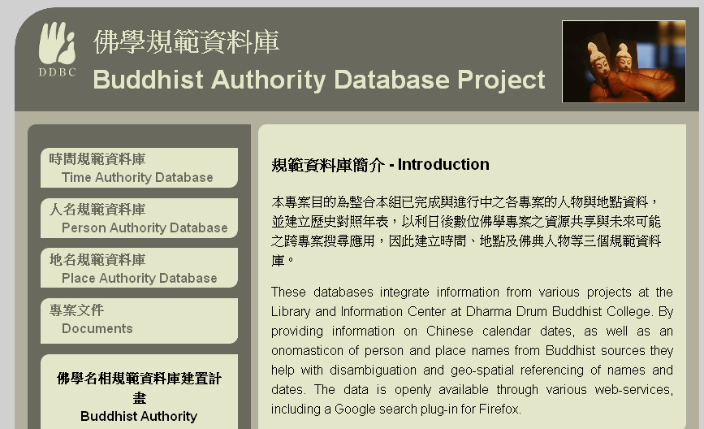
佛學規範資料庫
Buddhist Studies Authority Databases
http://authority.dila.edu.tw/
Data Range:
  Time Authority Database
    BCE 221/11/16 (Qin) -- CE 1912/01/12 (Qing)
    Chinese/Western/Japanese/Korean Calendar
  Person Authority Database
    More than 23000 persons
  Place Authority Database
    More than 58000 places

Slide 35
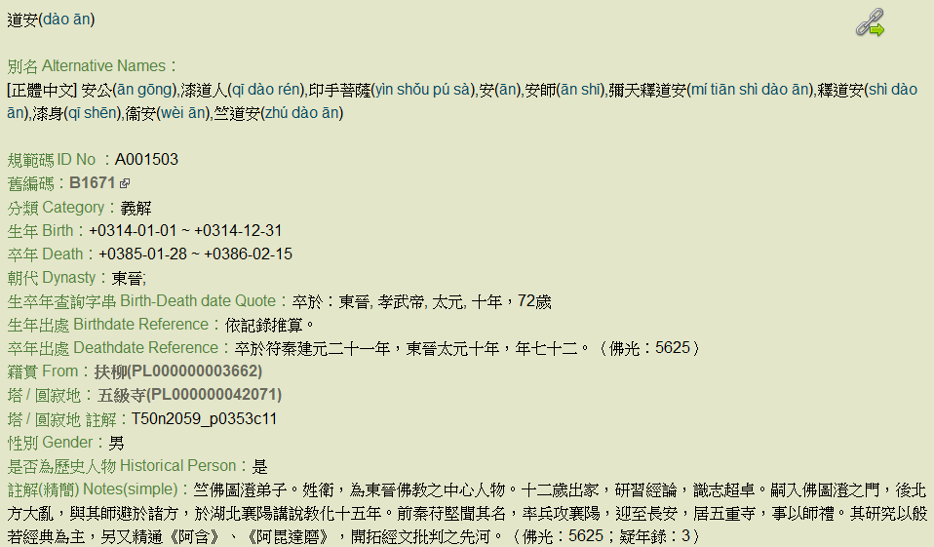
Example of Person Authority Record
Alternative Name
Birth and Death Record

Slide 36
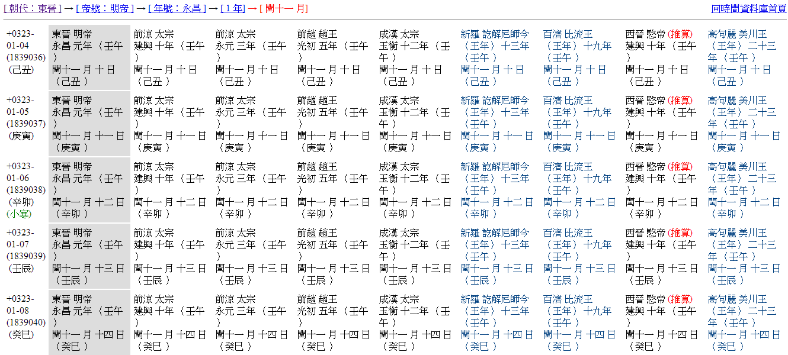
Example of Time Authority
Estimated Western Date
Parallel dynasties in China
Japanese and Korean calendar

Slide 37
Data in Place Authority Database
Current Scope:
  Chinese cities in 15 dynasties ( from Qin to Qing)
  Important Buddhist places in Asia
  More than 30000 places
Authority id and Names
Longitude, Latitude
  Kml Download
  Online Google Map
Administrative area
Dynasty
Note(use to indentify this place):
Sources

Slide 38
Access Source Data
Download > Open Content Project
You can down whole databases dump for person, place and calendar databases.
The Least update date: May, 2017
Or you can visit our GitHub repository:
  https://github.com/ddbc/Authority-Databases

Slide 39
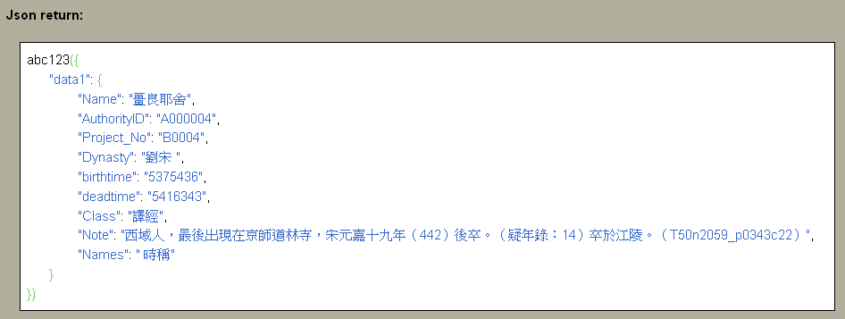
Access information through Data Service API
Access raw data with URL (ex: person query), data return in JSON format.
http://authority.ddbc.edu.tw/getAuthorityData.php?type=person&id=A000004&jsoncallback=abc123

